Slide 1


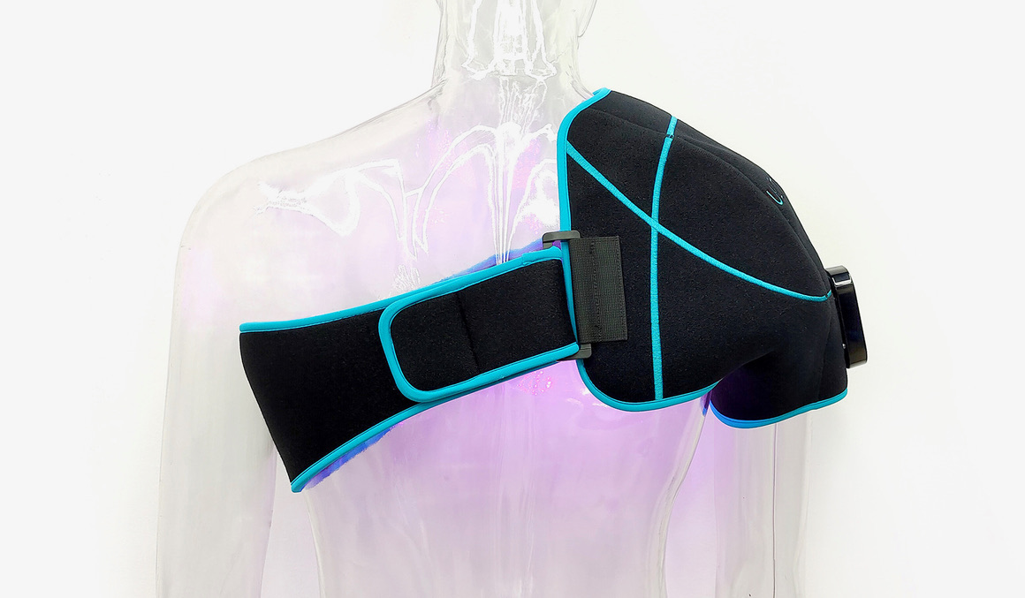
ULTRABEAM distributor training
Product knowledge and first-account preparation
For experienced VA medical-device distributors
Manufacturer information, clinical boundaries,
and a clear path through DMG onboarding
October 2026
DMG / ULTRABEAM distributor training
01
Notes:
This UltraBeam module focuses on product knowledge and first-account preparation. Keep the current Instructions for Use (IFU) available for all device-use questions. The treating clinician determines the treatment plan.
Sources checked 12 October 2026:
https://ultrapainpro.com/wp-content/uploads/2026/07/UltraBEAM-2026-product-spec-sheet.pdf
https://training.dmg.health/assets/04_Product_Training_and_Platform_Walkthrough.pptx
Product photograph supplied by Justin on October 14, 2026: shoulder wrap on demonstration mannequin, preserved original photo 10.jpg. Photo is illustrative; confirm supplied model/controller.

Slide 2
Training outcomes
The goal is a credible product discussion and a complete next step at the facility.
Product explanation
Describe the device and its stated topical-heating indications.
Safe handoff
Recognize the listed contraindications and route clinical questions correctly.
Account preparation
Match the wrap and SKU, then confirm the facility’s ordering requirements.
Readiness review
Complete the assessment and a DMG-provided practice order.
DMG / ULTRABEAM distributor training
02
Notes:
Use these outcomes to judge readiness. This module does not confer a clinical credential or establish an independent right to train patients. Ask each participant to name a current account they could use for the practical exercise. Confirm the completion requirements with your DMG onboarding owner.
Sources checked 12 October 2026:
https://training.dmg.health/assets/03_ULTRABEAM_Assessment.docx
https://ultrapainpro.com/wp-content/uploads/2026/07/UltraBEAM-2026-product-spec-sheet.pdf

Slide 3
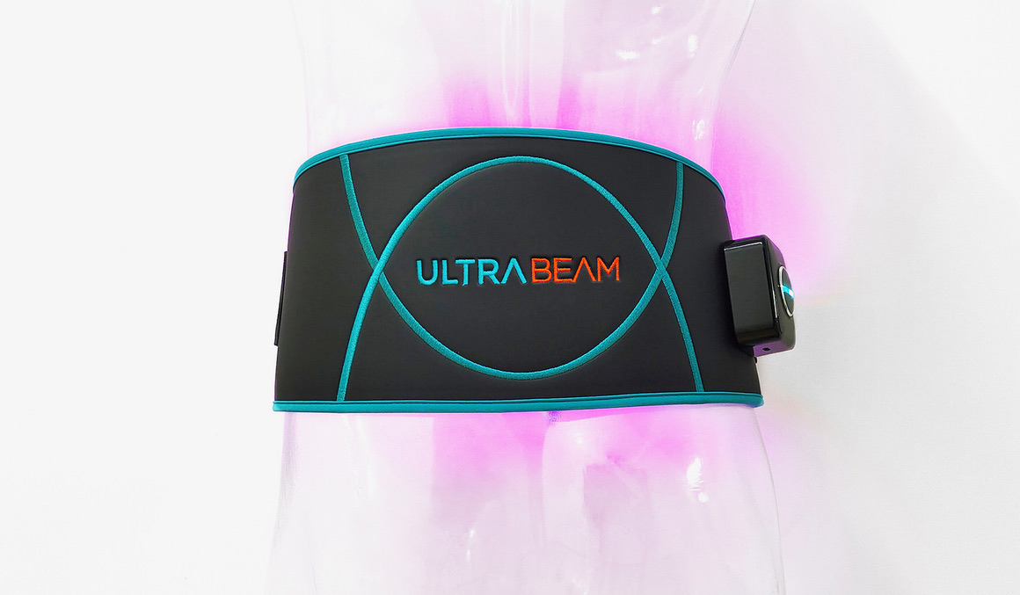
The ULTRABEAM system
A wearable LED device with a wrap for the prescribed treatment area
Light delivery
Blue, red, and near-infrared LEDs
deliver energy for topical heating.
Wrap options
Shoulder, cervical, back, knee,
and hand/wrist configurations
DMG / ULTRABEAM distributor training
03
Notes:
Identify the device before discussing its use. Use the terms in the current manufacturer sheet. The product page describes removable magnetic battery/controller components. Use the current model-specific IFU for controller operation and the current kit documentation to confirm components. The photograph identifies the form factor, not a fitting demonstration.
Sources checked 12 October 2026:
https://ultrapainpro.com/wp-content/uploads/2026/07/UltraBEAM-2026-product-spec-sheet.pdf
https://training.dmg.health/assets/04_Product_Training_and_Platform_Walkthrough.pptx
Product photograph supplied by Justin on October 14, 2026: back wrap on demonstration mannequin, preserved original photo 04.jpg. Photo is illustrative; confirm supplied model/controller.

Slide 4
Stated indications
The manufacturer describes infrared topical heating for these effects.
Temporary symptom relief
Minor muscle and joint pain, muscle spasms, and stiffness
Muscle relaxation
Relaxation of muscles and muscle tissue
Local heating and circulation
Raised tissue temperature and a temporary increase in local blood circulation
Use this scope when describing ULTRABEAM to a clinician.
DMG / ULTRABEAM distributor training
04
Notes:
The 2026 clinical information sheet is the main source for this slide. Paraphrase conservatively and retain qualifiers such as minor and temporary. Do not expand this into claims that the device heals wounds, treats infection, changes disease structure, reduces medication, or produces a proven postoperative outcome. A clinician determines whether the device is appropriate for an individual patient.
Sources checked 12 October 2026:
https://ultrapainpro.com/wp-content/uploads/2026/07/UltraBEAM-2026-product-spec-sheet.pdf

Slide 5
Wavelengths and specifications
The 2026 sheet reports three wavelengths for each wrap.
450 nm
650 nm
950 nm
Blue light
Red light
Near-infrared light
Each wrap has its own reported light output and LED count.
Use the exact model’s specification sheet for technical questions.
A wavelength alone does not establish treatment depth or clinical benefit.
DMG / ULTRABEAM distributor training
05
Notes:
The 2026 sheet reports 450, 650, and 950 nm. Technical measurements differ by wrap. Avoid unsupported wavelength-specific healing, antibacterial, or depth claims. The sheet also reports wrap temperatures measured after 10 and 30 minutes. Those are characterization data, not tissue-temperature outcomes and not permission for continuous 30-minute treatment. The treatment schedule comes from page 1.
Sources checked 12 October 2026:
https://ultrapainpro.com/wp-content/uploads/2026/07/UltraBEAM-2026-product-spec-sheet.pdf

Slide 6
Manufacturer treatment schedule
User manual and quick-start guide
10 minutes
3 courses
2 hours
One treatment course
Maximum per day
At least two hours between sessions
The controller ends each course automatically.
Follow the manual and clinician guidance. Ask DMG before treating multiple areas.
DMG / ULTRABEAM distributor training
06
Notes:
Follow the supplied UltraBEAM user manual and quick-start guide: sessions last ten minutes, allow at least two hours between sessions. Quick-start limit is three sessions in 24 hours. The operating-page per-treatment-area limit versus total daily quick-start wording requires manufacturer clarification; ask DMG before planning multiple areas. Follow any more restrictive clinician instructions. Source: https://training.dmg.health/assets/UltraBEAM_User_Manual_Quick_Start_Web_Reading_Copy.pdf, operating page 3 and quick-start page 7. Updated October 14, 2026.

Slide 7
Manufacturer contraindications
A concern on this list needs clinical review before device-use education proceeds.
Patient factors
Exposure and treatment areas
Light-sensitive skin, including
medication-related light sensitivity
Pregnancy, particularly application
over the abdomen
Direct light exposure to the eyes
Cancerous lesions
Thyroid gland
Areas of active infection
A cervical wrap still requires placement that avoids the thyroid gland.
DMG / ULTRABEAM distributor training
07
Notes:
These six contraindications come from page 1 of the current manufacturer sheet. This slide is a summary, not a complete safety manual. Do not infer suitability from wrap shape. If someone reports a photosensitizing medication, do not improvise a shorter dose or tell them to change medication. Refer the concern to the treating clinician and DMG. Obtain the current IFU for the complete safety and placement instructions before hands-on training.
Sources checked 12 October 2026:
https://ultrapainpro.com/wp-content/uploads/2026/07/UltraBEAM-2026-product-spec-sheet.pdf
https://training.dmg.health/assets/03_ULTRABEAM_Assessment.docx

Slide 8
Patient support and escalation
The care team makes clinical decisions. The distributor supports the authorized process.
Before device education
Confirm the ordered model and current IFU, then use the matching DMG materials.
Symptoms or treatment changes
Refer the question to the treating care team. Record the concern through the approved process.
Equipment or instruction questions
Contact DMG when the device, document version, or setup guidance is unclear.
Distributor support: distributorsupport@dmg.health
DMG / ULTRABEAM distributor training
08
Notes:
Use the current manufacturer IFU for fitting, charging, cleaning, troubleshooting, and stop-use instructions. If a Veteran reports worsening symptoms, the distributor should not adjust treatment independently. For possible device issues, follow DMG’s complaint/adverse-event process. Do not put patient-identifying health information in ordinary email or in this assessment.
Sources checked 12 October 2026:
https://training.dmg.health/assets/03_ULTRABEAM_Assessment.docx
https://ultrapainpro.com/wp-content/uploads/2026/07/UltraBEAM-2026-product-spec-sheet.pdf
https://training.dmg.health/assets/Ultrabeam_WebEdition_Combined.pdf

Slide 9
Clinical evidence for ULTRABEAM
The manufacturer distinguishes general light-therapy research from evidence on this device.
The manufacturer states that ULTRABEAM has not
undergone independent or clinical testing.
Its cited studies used other devices and different treatment parameters.
For a study discussion, check the device, wavelengths, output, dose,
patient population, and outcome before deciding what it supports.
DMG / ULTRABEAM distributor training
09
Notes:
Source: the current manufacturer product page, disclaimer below the cited research. It states that UltraBeam has not been independently or clinically tested and that the cited studies did not use UltraBeam. Do not use any study percentage as an expected UltraBeam result. General PBM or LLLT research can provide background, but it cannot establish this product’s efficacy. No PainShield study, OnLux result, class-wide response rate, healing claim, medication-reduction claim, or comparative outcome belongs in the product claim set without separate approved evidence. This statement reflects the public manufacturer material checked on 12 October 2026.
Sources checked 12 October 2026:
https://ultrapainpro.com/ultrabe%CE%BBm/
https://training.dmg.health/assets/03_ULTRABEAM_Assessment.docx

Slide 10
Regulatory language
The 2026 manufacturer sheet identifies the device as an infrared therapeutic heating lamp.
Manufacturer-reported classification
Class II, product code ILY, regulation 21 CFR 890.5500
Manufacturer-reported pathway
510(k) exempt
Accurate representation
FDA registration or listing alone does not establish approval, clearance, or authorization.
For purchasing questions, provide the current regulatory and product-listing documentation.
DMG / ULTRABEAM distributor training
10
Notes:
Attribute product classification and exemption statements to the current manufacturer sheet. FDA’s Important Reminders page explains that establishment registration and device listing do not denote FDA approval, clearance, or authorization. Do not call the device FDA approved or use FDA branding. Regulatory status does not establish a VA buying decision, a clinical outcome, or the availability of a specific SKU on a particular contract. Confirm product-specific documentation with DMG.
Sources checked 12 October 2026:
https://ultrapainpro.com/wp-content/uploads/2026/07/UltraBEAM-2026-product-spec-sheet.pdf
https://www.fda.gov/medical-devices/device-registration-and-listing/important-reminders-about-registration-and-listing
https://training.dmg.health/assets/03_ULTRABEAM_Assessment.docx

Slide 11
Wraps and ordering SKUs
DMG’s supplied product list uses these identifiers. Reconfirm the current configuration before quoting.
Treatment wrap | DMG SKU
Shoulder | LLLTShoulder
Cervical | LLLTCervical
Back | LLLTBack
Knee | LLLTKnee
Hand and wrist | LLLTHandwrist
Confirm kit contents, price, product listing, and the facility’s purchasing route with DMG.
DMG / ULTRABEAM distributor training
11
Notes:
These identifiers appear in the supplied DMG UltraBeam product brochure on page 2 and slide 31 of the supplied deck. They are DMG ordering SKUs, not the manufacturer model numbers. The manufacturer’s 2026 sheet corroborates the five wrap types. Confirm current availability, kit contents, prices, contract eligibility, and substitutions before a quote or consult packet.
Sources checked 12 October 2026:
https://training.dmg.health/assets/Ultrabeam_WebEdition_Combined.pdf
https://training.dmg.health/assets/04_Product_Training_and_Platform_Walkthrough.pptx
https://ultrapainpro.com/wp-content/uploads/2026/07/UltraBEAM-2026-product-spec-sheet.pdf
https://training.dmg.health/assets/03_ULTRABEAM_Assessment.docx

Slide 12
A focused provider conversation
Use the device description, explain the evidence boundary, and agree on a specific next step.
ULTRABEAM is a wearable LED device that provides topical
heating for temporary relief of minor muscle and joint pain
and related symptoms described in its labeling.
The manufacturer has not established device-specific clinical outcomes.
I can provide the current product information and help confirm
your facility’s evaluation and ordering process.
Discussion prompt: What information would your team need to evaluate it?
DMG / ULTRABEAM distributor training
12
Notes:
Suggested language, not a required verbatim script. Adjust the discussion to the clinician’s question while preserving the stated indications and the evidence limitation. Ask what the team needs for an evaluation rather than promising a particular clinical result. If a competing device comes up, request the specific comparison question and obtain a documented, approved response from DMG. Similarity of modality does not establish equivalence or superiority.
Sources checked 12 October 2026:
https://ultrapainpro.com/wp-content/uploads/2026/07/UltraBEAM-2026-product-spec-sheet.pdf
https://ultrapainpro.com/ultrabe%CE%BBm/
https://training.dmg.health/assets/03_ULTRABEAM_Assessment.docx

Slide 13
The first-account ordering pathway
Confirm the local process with both the clinical team and Prosthetics or purchasing.
1. Clinical request and authorization
Identify the clinician’s requirements and the facility’s consult process.
2. Product and purchasing review
Verify the wrap, SKU, current quote, applicable listing, and ordering contact.
3. Purchase order and fulfillment
Confirm the purchase order before vendor fulfillment and technical assistance.
4. Delivery follow-through
Verify delivery, coordinate the appropriate support, and record the next action.
DMG / ULTRABEAM distributor training
13
Notes:
This is the workflow taught in the supplied DMG assessment, not a claim that every VA facility uses an identical process. Experienced distributors should map it to their account. Clinical interest alone is insufficient to ship. FSS or SDVOSB positioning may be relevant vendor information but does not guarantee authorization or establish that a particular product is listed. Ask DMG for the current applicable product and contracting documents. Use approved channels for any patient information.
Sources checked 12 October 2026:
https://training.dmg.health/assets/03_ULTRABEAM_Assessment.docx

Slide 14
Training materials and the partner platform
Use the right destination for the task.
Training website
Partner ordering platform
training.dmg.health
portal.dmg.health
Product references
ULTRABEAM assessment
Onboarding materials
Assigned account access
Order and shipment information
Approved order follow-through
For a practice order, use a DMG-provided sample with no patient data.
DMG / ULTRABEAM distributor training
14
Notes:
Use training.dmg.health for training resources and portal.dmg.health for authorized operational work. The assessment directs distributors to review the correct product, ordering facility, purchase order, shipment or tracking status, relevant contact details, and matching support materials. Use the access and workflow assigned to you by DMG.
Sources checked 12 October 2026:
https://training.dmg.health/assets/04_Product_Training_and_Platform_Walkthrough.pptx
https://training.dmg.health/assets/03_ULTRABEAM_Assessment.docx
https://training.dmg.health
https://portal.dmg.health

Slide 15
Discussion cases
Explain your response, the source you would use, and who owns the next action.
Light-sensitive medication
A prospective user reports medication-related sensitivity to light. What happens next?
Another device’s study
A clinician asks whether a published LED-therapy response rate applies to ULTRABEAM.
A delivered order
A Veteran has the device and asks you to change the treatment schedule.
DMG / ULTRABEAM distributor training
15
Notes:
Facilitator answers: (1) Flag the listed contraindication and refer to the treating clinician and DMG before device-use education. Do not change medication or improvise dose. (2) Explain that the manufacturer’s cited studies used other devices and that this does not establish an UltraBeam response rate. Obtain an approved, device-specific evidence response if one exists. (3) Verify the ordered device and appropriate support materials, refer treatment changes to the care team, and document the concern through the approved process. These cases align with the supplied assessment and are not real patient cases.
Sources checked 12 October 2026:
https://ultrapainpro.com/wp-content/uploads/2026/07/UltraBEAM-2026-product-spec-sheet.pdf
https://ultrapainpro.com/ultrabe%CE%BBm/
https://training.dmg.health/assets/03_ULTRABEAM_Assessment.docx

Slide 16
Distributor readiness checklist
Complete the product-specific work before your DMG readiness review.
Current documents
Locate the manufacturer sheet and current model-specific IFU. Resolve conflicting guidance.
Account plan
Name the clinical audience, purchasing contact, and next action for one facility.
Practice and assessment
Complete the ULTRABEAM assessment and the DMG sample-order exercise.
Completion summary
Send the requested completion items and open questions to your DMG onboarding owner.
DMG / ULTRABEAM distributor training
16
Notes:
Confirm your onboarding owner, completion submission route, and readiness requirements with DMG. Ask about any missing instructions before marking the checklist complete. General distributor support: distributorsupport@dmg.health.
Sources checked 12 October 2026:
https://training.dmg.health/assets/03_ULTRABEAM_Assessment.docx
https://training.dmg.health/assets/04_Product_Training_and_Platform_Walkthrough.pptx
https://training.dmg.health/assets/Ultrabeam_WebEdition_Combined.pdf

Slide 17
Product references
Current sources for product questions and distributor onboarding
Manufacturer clinical and specification sheet
2026, two pages. Indications, schedule, contraindications, wrap specifications.
Manufacturer ULTRABEAM product page
Product description and explicit limits of device-specific clinical evidence.
DMG product list
DMG wrap SKUs and ordering identifiers.
ULTRABEAM distributor assessment
Knowledge questions, account scenarios, and practical onboarding activities.
FDA registration and listing reminder
Registration and listing do not establish approval, clearance, or authorization.
DMG / ULTRABEAM distributor training
17
Notes:
Use the manufacturer’s current clinical and specification sheet for product facts. DMG’s product list supplies the ordering SKU mapping. The assessment provides the practical exercises. Ask DMG for the current model-specific IFU and any additional approved evidence needed for a provider question.
Sources checked 12 October 2026:
https://ultrapainpro.com/wp-content/uploads/2026/07/UltraBEAM-2026-product-spec-sheet.pdf
https://ultrapainpro.com/ultrabe%CE%BBm/
https://training.dmg.health/assets/Ultrabeam_WebEdition_Combined.pdf
https://training.dmg.health/assets/03_ULTRABEAM_Assessment.docx
https://www.fda.gov/medical-devices/device-registration-and-listing/important-reminders-about-registration-and-listing
https://ultrapainpro.com/resources/

