Slide 1



Distributor Onboarding
Product training and a guide to the DMG partner platform. This deck covers PainShield and introduces ULTRABEAM. Review the separate resources for each product you represent.
Open the partner platform: portal.dmg.health
DMG | Distributor onboarding
01
Notes:
Onboarding overview. Territory and commercial terms remain governed by the distributor agreement and DMG confirmation. This guide does not establish new commercial terms.
Source: DMG Distributor Onboarding Video Corrected, original slide 1.

Slide 2
Your Onboarding Checklist
Complete these steps in order. Track your progress at training.dmg.health.
1. Account access
Sign in to the partner platform with your invited email address.
2. Product review
Review this PainShield module and the current product resources.
3. Portal practice
Locate Resources and work through a DMG-provided sample order.
4. Knowledge check
Complete the quiz for each assigned product and review your score.
5. Readiness review
Send your completion summary to DMG for review.
DMG | Distributor onboarding
02
Notes:
Complete account access, product review, platform practice and the product quizzes before requesting a readiness review. The training portal at https://training.dmg.health saves your progress and records quiz scores. Use https://portal.dmg.health for the partner platform.
Source: DMG Distributor Onboarding Video Corrected, original slide 2.

Slide 3
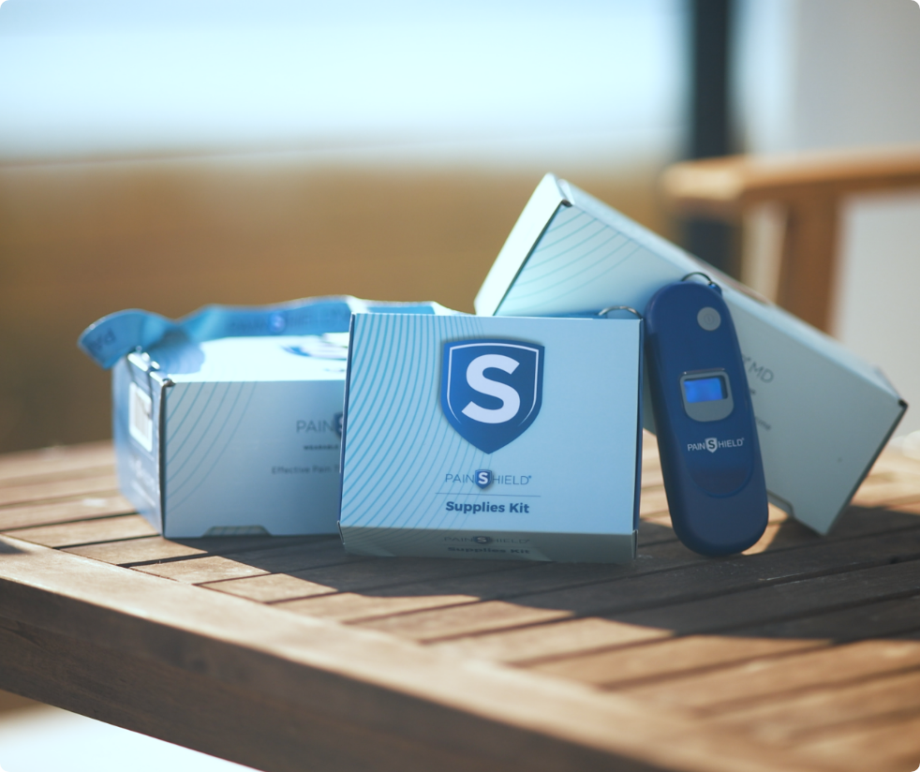
PainShield MD Wearable Ultrasound
Personal use, gel-free, Surface Acoustic Wave Ultrasound Therapy (SAWT) designed specifically for the Veterans Affairs healthcare system.
An opioid-free, hands-free, home-use solution for integrated pain management and injury recovery.
Justin A. Brooks, President
DMG | Distributor onboarding
03
Notes:
Source: DMG Distributor Onboarding Video Corrected, original slide 3.

Slide 4
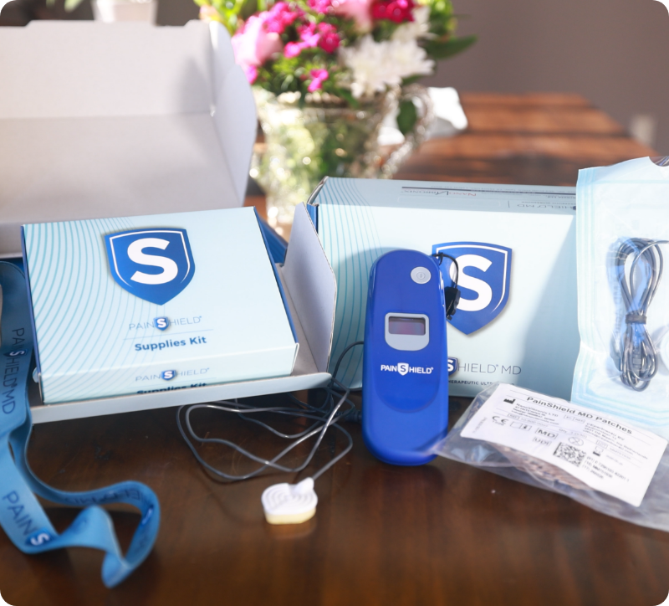
What PainShield Is
Wearable ultrasound therapy for VA patients, including overnight use
01
Surface Acoustic Wave (SAW) wearable ultrasound patch and driver unit.
02
Manual specification: 91 kHz ± 5 kHz, with 30 minutes on and 30 minutes off.
03
Gel-free, self-adhesive patch for hands-free operation day or night.
04
Intermittent cycles providing up to 6.5 hours of treatment per charge.
DMG | Distributor onboarding
04
Notes:
Source: NanoVibronix, PainShield MD User Manual USA, 20-100-0004 Ver 09, supplied on the DMG website: https://www.dmg.health/s/PainShield-Full-Manual.pdf (reviewed October 12, 2026). Pages 12 and 30: operating cycle and driver/actuator specifications. The specifications table gives 91 kHz ± 5 kHz. The manual introduction uses the rounded description 90 kHz. The 96 kHz setting on the research slides describes the historical study devices.

Slide 5
PainShield in VA Care
PainShield addresses chronic and persistent pain in Veterans while reducing dependence on opioids and improving long-term outcomes.
1/3
Veterans with Chronic Pain
1/5
Persistent Pain Rate
One in three Veterans suffer from chronic pain conditions requiring integrated care. Chronically painful conditions treated with DME in the VA can be subject to recurring "rental rates."
One in five Veterans experience persistent pain affecting daily functionality. Reduction of MRADLs or overall quality of life is far too prevalent in the VA population.
1/10
Severe Persistent Pain
8/10
Patients Respond Positively
One in ten Veterans face severe persistent pain. Treatment often involves strong opioid-based medication.
PainShield therapy treats a wide range of painful conditions. Eight in ten Veteran patients report a positive response.
DMG | Distributor onboarding
05
Notes:
Source: DMG Distributor Onboarding Video Corrected, original slide 5.

Slide 6

Pain and Opioid Safety Context
VA goals include reducing opioid dependence and addressing deaths linked to overdose and suicide.
01
VA mortality from opioid overdose is significantly higher than the general population.
02
Veteran suicide rates are directly linked to untreated or severe chronic pain.
03
PainShield aligns with VA goals as a non-opioid adjunct therapy to reduce analgesic use.
DMG | Distributor onboarding
06
Notes:
Source: DMG Distributor Onboarding Video Corrected, original slide 6.

Slide 7
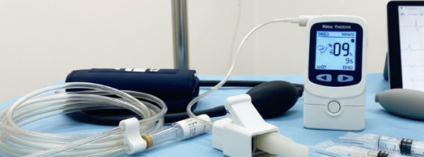
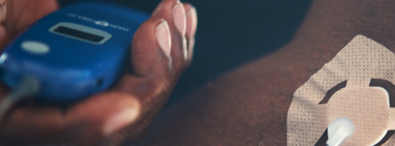
Conventional Treatments vs PainShield
PainShield is a non-invasive alternative or complement to pharmacological and surgical treatments.
Conventional Treatments
PainShield Solution
Reliance on drugs, injections, surgery, and stationary clinic-based devices.
Non-invasive, wearable ultrasound with high patient satisfaction and industry-leading protocol compliance.
DMG | Distributor onboarding
07
Notes:
Source: DMG Distributor Onboarding Video Corrected, original slide 7.

Slide 8
Common Clinical Indications
Conditions covered in PainShield training include neuropathic pain and postoperative recovery.
Tendinopathic and Soft Tissue Injuries
Neuropathic and Rheumatologic Pain
Postoperative Recovery
Cervical, Thoracic and Joint Discomfort
Ankle lateral ligament sprain (ATFL, CFL) (MCL) sprain (ACL) sprain
Glenohumeral instability/capsular injury
Diabetic Peripheral Neuropathy
Trigeminal neuralgia
Radiculopathy
Rheumatoid Arthritis
Osteoarthritis
Phantom Limb Pain
Orthopedic postoperative conditions
Cervical spondylosis
Degenerative disc disease
Myofascial pain
Thoracic spine strain
Thoracic radiculopathy
DMG | Distributor onboarding
08
Notes:
Source: DMG Distributor Onboarding Video Corrected, original slide 8.

Slide 9
Mechanism of Action
How low-frequency ultrasound facilitates tissue healing and pain reduction through biological stimulation.
Enhanced Circulation
Increases local circulation and vascular permeability to promote healing.
Protein Secretion
Stimulates protein secretion and enzymatic activity at the target site.
Nitric Oxide Production
Boosts nitric oxide production to aid in tissue recovery and vasodilation.
Oxygen Saturation
Increases local TcPO2 saturation levels within minutes of initiating therapy.
Cell Proliferation
Supports fibroblast proliferation for structural tissue repair.
DMG | Distributor onboarding
09
Notes:
Source: DMG Distributor Onboarding Video Corrected, original slide 9.

Slide 10
Technical Differentiators
Technical specifications of PainShield SAW and conventional stationary ultrasound devices
Feature | PainShield (SAW) | Conventional Ultrasound
Frequency | 91 kHz ± 5 kHz (user manual specification) | 1-3 MHz (High = limited placement locations, requires gel)
Intensity | 70 mW/cm2 (Low) | Higher Intensity
Propagation | ~10 cm radius around transducer = larger tissue recruitment area | Under Transducer
Depth | 2-4 cm | Variable
Gel Requirement | Not Required = higher compliance to protocol | Required = potentially a barrier to safe at home use
DMG | Distributor onboarding
10
Notes:
Source: NanoVibronix, PainShield MD User Manual USA, 20-100-0004 Ver 09, supplied on the DMG website: https://www.dmg.health/s/PainShield-Full-Manual.pdf (reviewed October 12, 2026). Page 30: the driver and actuator frequency specification is 91 kHz ± 5 kHz. The manual introduction uses 90 kHz as a general description. Other comparison details come from the supplied DMG training deck.

Slide 11

Clinical Evidence Highlights
Study results in trigeminal neuralgia, diabetic neuropathy with ischemia, and tendonitis
~55%
70%
46.4%
Trigeminal Improvement
Tennis Elbow Success
Breakthrough Medication Reduction
Reduction in trigeminal neuralgia VAS pain score after four weeks, versus about 2% with sham treatment.
Interim results showing significant improvement or resolution.
Reduction in breakthrough medication usage during clinical study.
DMG | Distributor onboarding
11
Notes:
Source: Markowitz et al. (2019), The Effect of Surface Acoustic Wave (SAW) Device on the Symptomatology of Trigeminal Neuralgia, pages 2–3: https://training.dmg.health/assets/Trigeminal_Neuralgia_Study.pdf. The active group mean VAS changed from 8.12 to 3.65 (55.05% reduction from baseline) at four weeks; the sham group changed from 8.00 to 7.82 (2.25%). Weekly breakthrough-medication use changed from 16.06 to 8.61 (46.4%) in the active group and 14.39 to 14.17 (1.52%) with sham. These are different outcomes. The tennis elbow figure remains from the supplied DMG training deck.

Slide 12
Study Extracts: Rosenblum 2014 vs Markowitz 2019
Historical study designs. Current device labeling and contraindications govern treatment.
Category | Rosenblum et al., WOUNDS 2014 (CLI) | Markowitz et al., J Anesthesiology Pain Res 2019 (Trigeminal Neuralgia)
Design | Prospective single-center clinical evaluation, nonrandomized | Double-blind randomized sham-controlled trial (IRB approved)
N / demographics | 10 patients (6F/4M), age 40–75; ABI < 0.4; 2 with toe necrosis | 59 completers (30M/29F), age 36–68; TN ≥ 9 months; stable analgesic regimens
Device & settings | Study device: PainShield SAW, fixed 96 kHz; 30 min on / 30 min off; patch on dorsal foot proximal to MTP | Study device: PainShield SAW, approximately 96 kHz; nightly ~6.5 hr; 30 min on / 30 min off; patch on lateral face over trigeminal distribution
Indication / population | Critical limb ischemia (ischemic feet; 2 with toe necrosis; no participants with open wounds) | Trigeminal neuralgia (symptomatic TN patients using baseline meds)
Intervention duration & placement | Single 30 min in-clinic active session with TcPO2 monitoring; 2 patients used nightly home cycles ~6.5 hr/night × 30 days | Nightly home use for 30 nights; ~6.5 hr/night; daily VAS and med logs; follow-up at 30 days
DMG | Distributor onboarding
12
Notes:
Source: Rosenblum et al. (2014), Surface Acoustic Wave Patch Therapy Affects Tissue Oxygenation in Ischemic Feet: https://www.hmpgloballearningnetwork.com/site/wounds/article/surface-acoustic-wave-patch-therapy-affects-tissue-oxygenation-ischemic-feet. This historical exploratory study included 10 people, none with open wounds; two had toe necrosis. The study assessed one 30-minute session; only two participants continued home use for one month. It does not establish open-wound safety or provide a current treatment protocol.
Source: Markowitz et al. (2019), The Effect of Surface Acoustic Wave (SAW) Device on the Symptomatology of Trigeminal Neuralgia, pages 2–3: https://training.dmg.health/assets/Trigeminal_Neuralgia_Study.pdf. The active group mean VAS changed from 8.12 to 3.65 (55.05% reduction from baseline) at four weeks; the sham group changed from 8.00 to 7.82 (2.25%). Weekly breakthrough-medication use changed from 16.06 to 8.61 (46.4%) in the active group and 14.39 to 14.17 (1.52%) with sham. These are different outcomes.
Current use must follow the PainShield MD User Manual USA, 20-100-0004 Ver 09: https://www.dmg.health/s/PainShield-Full-Manual.pdf. Page 7 contraindicates use directly over ischemic tissue in people with vascular disease and directly over open wounds. The 96 kHz values on these research slides describe the study devices, not the current specification table.

Slide 13
Study Extracts: Rosenblum 2014 vs Markowitz 2019
Historical study results. Current device labeling and contraindications govern treatment.
Category | Rosenblum et al., WOUNDS 2014 (CLI) | Markowitz et al., J Anesthesiology Pain Res 2019 (Trigeminal Neuralgia)
Primary endpoints measured | Transcutaneous oxygen pressure (TcPO2) before/during/15 min after treatment; pain VAS in 2 extended-use patients | Daily VAS pain scores (0–10); weekly breakthrough medication use; QOL questionnaires
Key quantitative outcomes | All 10: TcPO2 rose during treatment (~14%–169%) and stayed above baseline 15 minutes later. Two home-use patients: baseline TcPO2 nearly doubled after 1 month (e.g., 16 to 34 mmHg), reaching up to 49 mmHg at treatment end. Pain VAS in those 2 patients: 9 to 2 and 8 to 3. One reduced methadone use from 5/day to 1/day. | VAS baseline: active 8.12, sham 8.00. Week 4: 3.65 versus 7.82 (p<0.01), about 55% versus 2% reductions. Weekly breakthrough-medication uses: active 16.06 to 8.61 (~46%); sham 14.39 to 14.17 (~1.5%). QOL: ~25% change in the active group. The between-group difference was not statistically significant.
Safety / tolerability | No complications reported | No adverse events; minor patch adhesion issues resolved easily
Bottom line conclusion | SAW increased local TcPO2 in ischemic feet in the short term. Two people using it nightly showed sustained baseline TcPO2 increases and pain/function improvements. | At 4 weeks, active-group VAS pain fell ~55% and weekly breakthrough medication use ~46% from baseline. Sham VAS pain fell ~2%. No adverse events reported.
DMG | Distributor onboarding
13
Notes:
Source: Rosenblum et al. (2014), Surface Acoustic Wave Patch Therapy Affects Tissue Oxygenation in Ischemic Feet: https://www.hmpgloballearningnetwork.com/site/wounds/article/surface-acoustic-wave-patch-therapy-affects-tissue-oxygenation-ischemic-feet. This historical exploratory study included 10 people, none with open wounds; two had toe necrosis. The study assessed one 30-minute session; only two participants continued home use for one month. It does not establish open-wound safety or provide a current treatment protocol.
Source: Markowitz et al. (2019), The Effect of Surface Acoustic Wave (SAW) Device on the Symptomatology of Trigeminal Neuralgia, pages 2–3: https://training.dmg.health/assets/Trigeminal_Neuralgia_Study.pdf. The active group mean VAS changed from 8.12 to 3.65 (55.05% reduction from baseline) at four weeks; the sham group changed from 8.00 to 7.82 (2.25%). Weekly breakthrough-medication use changed from 16.06 to 8.61 (46.4%) in the active group and 14.39 to 14.17 (1.52%) with sham. These are different outcomes.
Current use must follow the PainShield MD User Manual USA, 20-100-0004 Ver 09: https://www.dmg.health/s/PainShield-Full-Manual.pdf. Page 7 contraindicates use directly over ischemic tissue in people with vascular disease and directly over open wounds. The 96 kHz values on these research slides describe the study devices, not the current specification table.

Slide 14
Use Cases and Patient Profiles
Conditions and patient profiles covered in PainShield training
Target Conditions
Patient Profile
Plantar fasciitis
Orthopedic injuries or repairs
Sprains and fractures
Ligament injuries
Tendonitis / tendinopathy
Neuropathy
Arthritic pain
Carpal tunnel syndrome
Trigeminal neuralgia
Candidates for home-based, hands-free ultrasound therapy.
DMG | Distributor onboarding
14
Notes:
Source: DMG Distributor Onboarding Video Corrected, original slide 14.

Slide 15
Wearable SAW vs Other Wearable DME
PainShield stands out against alternative wearable ultrasound and TENS devices in both clinical efficacy and patient convenience.
Compared to High-MHz Ultrasound
Compared to TENS/E-stim
Gel-free use improves protocol compliance
Safe for overnight treatment, including during sleep
Ease of use and a high safety profile encourage regular use
Restorative and neovascular effects in addition to pain relief
No electric-shock sensation
Pain reduction can continue beyond active use
Simple placement and single-button operation
DMG | Distributor onboarding
15
Notes:
Source: DMG Distributor Onboarding Video Corrected, original slide 15.

Slide 16
PainShield Safety and Precautions
Current user manual guidance. The treating clinician determines suitability and use.
Contraindications
Precautions and Other Devices
Do not use in these areas or situations:
Cancer and bone metastases in the treatment area
Directly on the eye or over an open wound
Directly over ischemic tissue in people with vascular disease
Over the uterus during pregnancy
Over bone growth centers before growth is complete
Use caution after a laminectomy involving major tissue removal, in people prone to bleeding, and over anesthetized areas of impaired skin.
For adults age 22 and older.
Safety and effectiveness have not been established in patients treated with pacemakers, electrical stimulators, radiofrequency generators, surgical meshes, IUDs or other surgical implants.
Review the full manual and follow clinician guidance.
DMG | Distributor onboarding
16
Notes:
Source: NanoVibronix, PainShield MD User Manual USA, 20-100-0004 Ver 09, supplied on the DMG website: https://www.dmg.health/s/PainShield-Full-Manual.pdf (reviewed October 12, 2026). Pages 7 to 9 list contraindications, warnings and precautions. The slide is a summary, not the full safety instructions. PainShield is not MRI compatible. Stop use and contact the treating medical professional if persistent redness, rash, itching, pain, swelling or another abnormality occurs. The treating clinician must determine suitability and use.

Slide 17
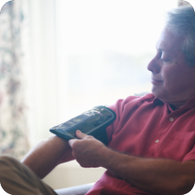
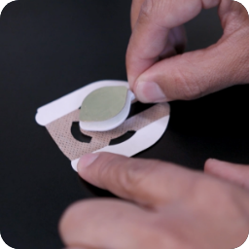
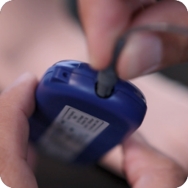
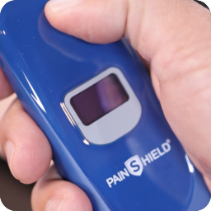
How to Use PainShield
Four steps for starting therapy at home
Verify Candidacy
Apply Patch
Connect Driver
Start Cycles
Confirm the patient is a suitable candidate for wearable ultrasound therapy.
Apply the gel-free SAW patch to the treatment site. Secure it with the supplied adhesive patches, medical tape or an elastic wrap.
Connect the SAW patch to the driver unit and secure the connection.
Start automated 30-minute active/passive cycles with a single button, for up to 6.5 hours per charge.
DMG | Distributor onboarding
17
Notes:
Source: DMG Distributor Onboarding Video Corrected, original slide 17.

Slide 18
Workflow for VA Ordering
The consult, purchase order and fulfillment process
01
Clinical Consult
Initiate the clinical consult and obtain the necessary authorization.
02
Prosthetics PO
Prosthetics or Procurement generates the purchase order (PO) for the device.
03
Vendor Fulfillment
Delta Medical Group, an SDVOSB vendor, contacts the patient to arrange delivery and technical assistance.
DMG | Distributor onboarding
18
Notes:
Source: DMG Distributor Onboarding Video Corrected, original slide 18.

Slide 19
Pricing, Bundles and Benefits
Treatment bundles, cost considerations and technical support
Treatment bundles
VA bundles include the supplies needed for 4-, 6- or 12-month treatment plans through a single consult. Devices are purchased rather than rented.
Cost considerations
Potential savings come from fewer clinic visits, device rentals and surgeries. Pricing is 50–90% lower than other VA ultrasound or diathermy devices, including SAM and Replexa.
Service after ordering
Delta Medical Group handles orders and provides technical support directly to Veterans, reducing the need for clinic visits.
DMG | Distributor onboarding
19
Notes:
Source: DMG Distributor Onboarding Video Corrected, original slide 19.

Slide 20
PainShield Bundle Ordering Details
Product identifiers and prices shown in the supplied capability statements
Product | Identifier | Supplied price
PainShield Starter Bundle | 3502-3 | $2,426.85
Multi Site Therapy Kit | 3502-2x | $3,870.00
Six-month refill kit | 101-6 | $1,664.30
Twelve-month refill kit | 101-12 | $3,332.00
Confirm the current quote and included supplies with DMG before submitting an order.
DMG | Distributor onboarding
20
Notes:
Sources: Capabilities Statment_Regular Bundle_Combined.pdf page 1 and Capabilitiy Statement_Multi Site_Combined.pdf page 1, supplied October 12, 2026. Prices reflect the supplied collateral and are not independently verified current FSS pricing. Confirm the current quote, refill quantities and treatment duration with DMG before ordering.

Slide 21
Common Product Questions
Questions about evidence, safety and long-term use
Is there evidence?
What if the patient feels little or no sensation?
Evidence includes PM&R tendon cases, a trigeminal neuralgia study and tennis elbow follow-ups. VA providers have reported positive results among thousands of Veterans treated across VISNs.
Low-intensity ultrasound works at the cellular level. Improvements can appear after as little as one week of daily use.
Placement near an open wound?
Place the actuator on healthy skin next to the wound, never over it. Follow the current manual and clinician instructions. Device and implant precautions also apply.
How long do effects last?
Studies show pain reduction that continues beyond active treatment. Patients should complete the full 30 days of use to support the best possible outcome.
How does the cost compare?
PainShield is the lowest-cost true ultrasound device. Comparable VA therapies cost 2–10 times more and are often offered as rentals.
DMG | Distributor onboarding
21
Notes:
Source: NanoVibronix, PainShield MD User Manual USA, 20-100-0004 Ver 09, supplied on the DMG website: https://www.dmg.health/s/PainShield-Full-Manual.pdf (reviewed October 12, 2026). Page 24 specifies placement on healthy skin near an open wound and prohibits placement on the wound. Page 9 states that safety and effectiveness have not been established in patients treated with the listed medical devices and implants. Other questions summarize the supplied DMG training.

Slide 22
VA Outreach and Follow-up
Key contacts and the sequence for introducing PainShield at VA facilities
Key Decision Makers
Sequence
Initial vendor support: Prosthetics
Clinical contacts: Podiatry, Orthopedics, PM&R, OT/PT, Neurology and Pain Management
Prosthetics
Providers and Prosthetics
Committee review, if needed
Patient selection based on indications
Clinical consult and purchase order
Patient technical support
Clinician follow-up
DMG | Distributor onboarding
22
Notes:
Source: DMG Distributor Onboarding Video Corrected, original slide 21.

Slide 23
Supporting Veterans and Distributors
DMG is a service-disabled Veteran-owned organization staffed by Veterans. We are committed to serving those who served our country.
We bring the same commitment to supporting our distributor partners.
DMG | Distributor onboarding
23
Notes:
Source: DMG Distributor Onboarding Video Corrected, original slide 22.

Slide 24
Daily Work in the Partner Platform
Order details and follow-up notes support continuity from delivery to clinician follow-up.
01
ACH and New Order Notifications
Review payment and new patient order notifications as they arrive.
02
Order and Patient Details
Review the product, patient, facility and order date, along with tracking, commission and contact details.
03
Technical Support
Contact the patient for technical support and share the quick-start video for their device.
04
Order Notes
Save the details you need for the next follow-up in the app.
05
Provider Follow-up
Find saved notes and order history by patient, VA facility, date or PO number when preparing for clinician follow-up.
DMG | Distributor onboarding
24
Notes:
Source: DMG Distributor Onboarding Video Corrected, original slide 23.

Slide 25
VA Facility Coverage
Coverage shown on the current DMG About page, reviewed October 12 2026
VISN | Examples listed on the DMG website
2 | Albany, Buffalo, Canandaigua, Syracuse
5 | Clarksburg, Huntington, Baltimore, Martinsburg, Washington DC
7 | Atlanta, Birmingham, Dublin, Montgomery, Augusta, Charleston
8 | San Juan, Gainesville, Tampa, Miami, Broward, Orlando
9 | Mountain Home, Lexington, Memphis, Louisville, Tennessee Valley
21 | Fresno, Reno, North Las Vegas
22 | Prescott, Phoenix, Tucson, Long Beach
View the full facility list at dmg.health/about
DMG | Distributor onboarding
25
Notes:
Source: https://www.dmg.health/about, reviewed October 12, 2026. The facilities shown are examples, not an exhaustive directory. Confirm current facility coverage and your assigned territory with DMG.

Slide 26
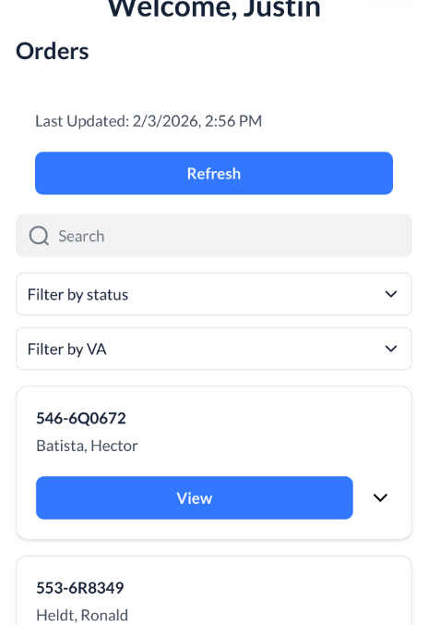
Metrics to Track
Use the DMG app to record therapy use and patient feedback for provider follow-up.
01
Protocol adherence and daily use: at least one session daily for 30 days. Ask: Did you use your device as prescribed?
02
Patient feedback. Ask: How did you find the therapy sessions?
03
Pain and daily function over 4–6 weeks. Ask: On a scale of 1–10, what was your pain when you started, and what is it now?
04
Patient recommendation. Ask: Would you recommend this device to another Veteran?
DMG | Distributor onboarding
26
Notes:
Source: DMG Distributor Onboarding Video Corrected, original slide 25.

Slide 27

Partner Platform Practice
Practice signing in, finding Resources and reviewing a sample order. Note any questions for your readiness review.
DMG | Distributor onboarding
27
Notes:
Source: DMG Distributor Onboarding Video Corrected, original slide 26.

Slide 28
Partner Platform Access
Account access, mobile use, and your assigned records
01
Use your invited email address to sign in at portal.dmg.health.
02
Confirm access on the desktop or mobile device you plan to use.
03
Check that available records and resources match your assigned role.
04
Locate Orders and Resources. Contact DMG if either is unavailable.
DMG | Distributor onboarding
28
Notes:
This example screenshot comes from the supplied training deck. Screens and available records may vary by partner role. Use your invited email at https://portal.dmg.health.
Source: DMG Distributor Onboarding Video Corrected, original slide 27.

Slide 29
Product Resources
Current materials for provider conversations and technical support
PainShield
ULTRABEAM
Wearable ultrasound therapy
Product information and supporting studies
Patient quick-start materials
Current ordering and bundle details
Wearable LED light therapy
Separate product specifications and literature
Patient instructions for this device
Current ordering and bundle details
DMG | Distributor onboarding
29
Notes:
Resource availability may vary by account. Locate one clinician resource and one patient resource for each product you represent. Record any missing documents or questions for your readiness review. Use the separate instructions and resources for each product.
Source: DMG Distributor Onboarding Video Corrected, original slide 28.

Slide 30
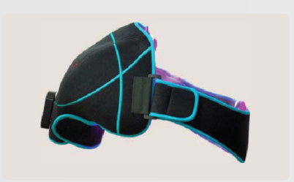
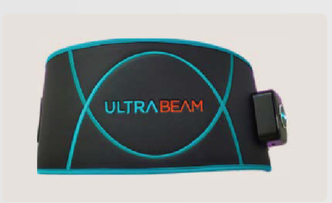
ULTRABEAM Product Overview
Wearable LED light therapy with separate product instructions and supporting resources
Treatment approach
Home use
Blue, red, and near-infrared light with topical heating for temporary relief of minor muscle and joint pain, stiffness, and muscle spasms.
Body-specific wraps for the shoulder, cervical area, back, knee, and hand/wrist. Ten-minute sessions shut off automatically.
DMG | Distributor onboarding
30
Notes:
Sources: supplied Ultrabeam_WebEdition_Combined.pdf pages 1 to 2; current dmg.health medical devices and ULTRABEAM pages, reviewed October 12 2026. See current manufacturer instructions for patient suitability and use. Broader light therapy research is separate from device-specific evidence.

Slide 31
ULTRABEAM Wraps and Ordering SKUs
Specify the correct wrap SKU when preparing product or consult information
Treatment wrap | SKU
Shoulder | LLLTShoulder
Cervical | LLLTCervical
Back | LLLTBack
Knee | LLLTKnee
Hand and wrist | LLLTHandwrist
DMG | Distributor onboarding
31
Notes:
Source: Ultrabeam_WebEdition_Combined.pdf page 2, supplied October 12, 2026. Confirm the wrap SKU in the ordering system and verify the purchasing route, current pricing and product instructions with DMG.

Slide 32
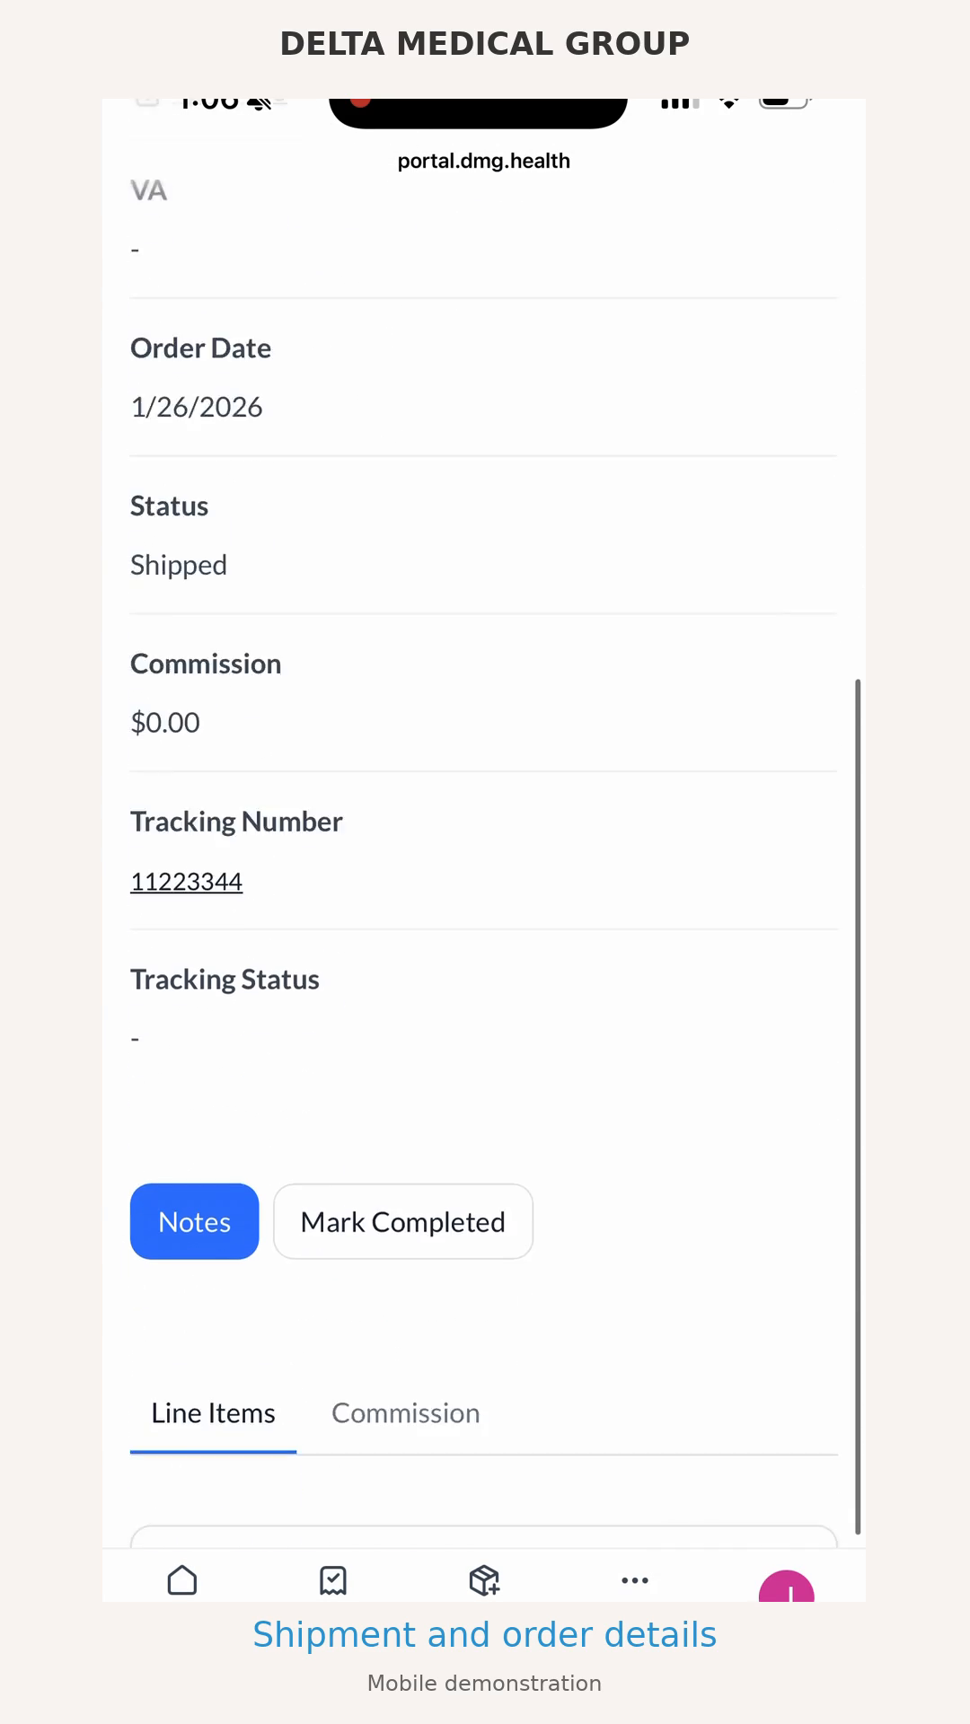
Mobile Platform Walkthrough
Watch the mobile demonstration, then try the sample order exercise.
Look for order details, shipment tracking, and the Resources tabs. Click the video to play the 24-second demonstration.
Click the video in Slide Show mode
DMG | Distributor onboarding
32
Notes:
Embedded H.264 MP4 mobile walkthrough supplied by DMG. Click the video in slide show mode to play. The walkthrough uses test data. After viewing, practice finding an order, locating shipment information, and finding the appropriate resource. Playback depends on the presentation application. The PDF or static preview displays the poster frame.

Slide 33
Sample Order Exercise
Use a DMG-designated test record. Request one if it is unavailable.
01
Order review
Locate the PO, facility, product, shipment status, and tracking details.
02
Support preparation
Find the quick-start materials that match the ordered device.
03
Follow-up note
Record the next action in a training note. Follow DMG instructions for test notes.
04
Commission review
Locate commission details and identify how to raise a discrepancy.
DMG | Distributor onboarding
33
Notes:
Completion check: explain the order status, next action, and relevant resource without a live walkthrough.
Source: DMG Distributor Onboarding Video Corrected, original slide 30.

Slide 34
Product Knowledge Checks
Complete the quiz for each product you represent at training.dmg.health
PainShield quiz
Complete the PainShield quiz after reviewing the training and current product resources.
ULTRABEAM quiz
Complete the ULTRABEAM quiz if this product is part of your portfolio.
Your training record
Use your partner account email. The training portal saves your progress and records your quiz score.
Questions and next steps
Review your results and note any questions. Contact DMG if you need help before your readiness review.
DMG | Distributor onboarding
34
Notes:
Complete the separate product quizzes at https://training.dmg.health using the email associated with your partner account. The portal saves your progress and records quiz scores. Review your results and bring remaining questions to DMG. Quiz completion is one part of the readiness review.

Slide 35
Readiness Review
Send your completion summary to distributorsupport@dmg.health
01
I can sign in and find current materials for my assigned products.
DMG readiness confirmation
02
I can explain the treatment approaches and ordering workflow.
Include your name, account email, assigned products, and any questions. DMG will confirm the remaining steps before launch.
03
I completed the sample order exercise and can record the next action.
04
I completed the product quizzes, reviewed my scores and listed my remaining questions.
DMG | Distributor onboarding
35
Notes:
Your completion summary should include your name, invited account email, assigned products, assessment completion date, confirmation that you completed the sample order exercise, and any remaining questions. Send it to distributorsupport@dmg.health to request a readiness review. Before launch, confirm account access, product training, territory, agreement and support responsibilities with DMG. Sending the email does not activate a territory.
Source: DMG Distributor Onboarding Video Corrected, original slide 32.

Slide 36
Help During Onboarding
Include the step, resource title, and what you expected to happen.
Cannot sign in?
Check your invited email address. Send DMG the error message and the device and browser you are using.
Missing a resource?
Identify the product and document so DMG can check availability and permissions.
Order or commission issue?
Reference the PO through the approved support channel. Avoid patient details in general email.
Product or clinical question?
Record the question for DMG. Use current manufacturer instructions and clinician direction.
Who can help?
Contact distributorsupport@dmg.health with your onboarding questions.
DMG | Distributor onboarding
36
Notes:
Source: DMG Distributor Onboarding Video Corrected, original slide 33.

